Slide 1

Strategies For Hennepin County SNAP Program
Team Apple: Nick Li, Sherry Tang,Yuzy Ye
Notes:
Hello! We are team Apple, and today we will present our findings and suggestions of SNAP program performance in Hennepin County. I am Yuzy, and my teammates are Nick and Sherry.

Slide 2
SNAP coverage rate calculation Purpose and Methodology for Hennepin County
Part 1
Notes:
We will start off with an overview of the methodology we used to calculate SNAP performance, as well as the rationale behind our choices

Slide 3


We leverage data to drive impactful food hunger decisions in Hennepin County
8.1%* Food insecurity rate in Hennepin County for 2018
Assess and improve SNAP coverage rates to reduce hunger
Previously
How timely applications are processed
Error rate of application
Our metrics
Use external data to calculate coverage rate based on reality
Data source: Feedingamerica, 2018/ Hennepin county
Notes:
We’re trying to define performance of SNAP in Hennepin county because food security is an issue. 8.1% of population in Hennepin county is experiencing food insecurity in 2018. The SNAP program helps them meet their hunger needs, but not everyone who is eligible participates. We need a measure to assess to what extent the SNAP program is failing to reduce food disparities in qualifying individuals? That way, we can compare performance across geography and demographics, discover reasons for low participation rates.
Past attempts at estimating how well the SNAP program is doing in Hennepin County include processing time and precision of SNAP applications. While this successfully measures processing capacity and efficiency, it might overlook extent to which the program is covering individuals that qualify. We suggest a calculation more closely aligned with eligible population.

Slide 4




Step 1: Determine appropriate threshold for estimating eligible population
We provide a range estimate for SNAP eligibility population, from a conservative 165% to 130% of poverty level
Finding a more realistic SNAP coverage rate
Income Eligibility Threshold by category (* pctg of poverty)
Known (people data)
Non-Categorical
Categorical
130%
165%
(eligible population)
Categorical-adjusted rate
? Estimate ?
138%*
Data source: Department of Human Services, MN
*Applies to 2018, exact rate varies by year
Notes:
Take a look at our proposed equation to calculate snap coverage rate.
Given the data you provided of how many people are currently receiving SNAP benefits, we need to estimate the eligible population to arrive at SNAP coverage rate. First step in our method is deciding on a metric to estimate the total eligible population that qualify for SNAP aid.
From online information, here is a range of applicable income thresholds for a person to be eligible for SNAP. The income threshold is higher for the elderly and disabled. Thus, 165% poverty is the most conservative end with a chance of overestimating the eligible population, while 130% is the least conservative with potential of underestimation. We recommend 138%, calculated by extrapolating the categorical population versus the general population.
However, you are free to decide on the metric you use.

Slide 5
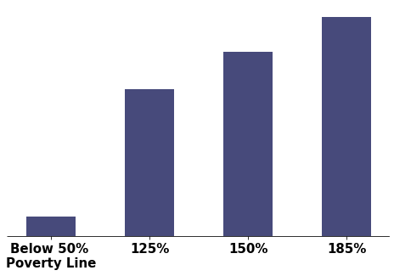
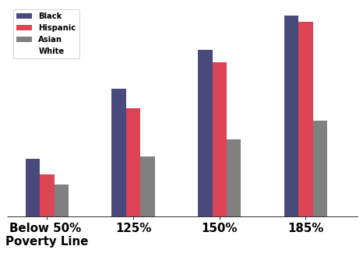
Step 2: Estimate the Eligible Population using income distribution curve
Finding a more realistic SNAP coverage rate
% of population
Eligible population is 13.6%
Tract income distribution
138%
% below poverty
Race income distribution
Data source: US Census Bureau
Notes:
Next on estimating the eligible pop. While we now have a threshold, we don’t have an actual number. We estimate eligible population number based off the threshold using the income distribution curve. For example at 138% poverty threshold, the eligible population is 13.6% of a particular tract.
Next, this percentage will be adjusted by race distribution in the tract. As you can see, each race contributes differently to the eligible population. Black in this case is relatively higher, while white is relatively lower.
Race adjustment calculations are in the appendix

Slide 6
SNAP Coverage Overview by Year; Power BI visualization representing race & geographical breakdown of coverage rate
Part 2
Notes:
For part 2, we are gonna talk about the overview of snap's coverage rate and use power bi to visualize it.

Slide 7
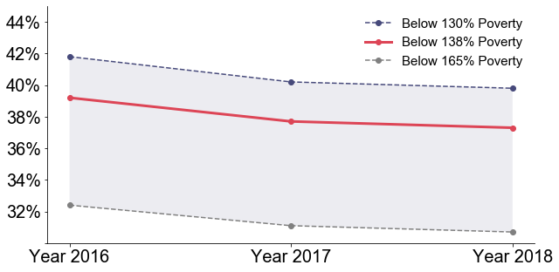
Overall, SNAP participation rate decreases over recent years 2016-2018
Reference: KFF Filling the need for trusted information on national health issues
Notes:
From 2016 to 2018, SNAP coverage rate decreases in recent years. We’re seeing an echo in this declining rate over the years for Minnesota state as a whole, which also has declining SNAP coverage rates.

Slide 8
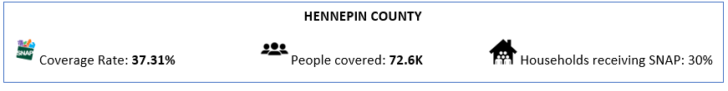
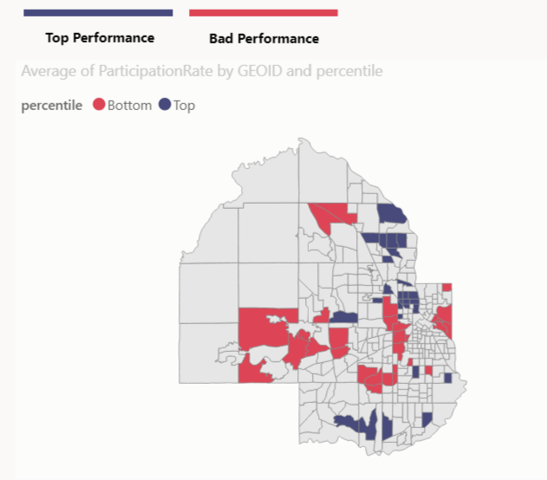
Particularly, 2018 Coverage Rate and Power BI
Our Power BI dashboard allows you to explore SNAP coverage at the granularity you prefer:
Most coverage,
Least coverage,
Specific track of interest
Race
etc.
Notes:
Here are some important information in 2018. we will display them in powerbi dashboard

Slide 9
Insights and Recommendations: Factors affecting SNAP coverage and suggestions for improvement
Part 3
Notes:
Next will give some insights to help increase SNAP coverage.

Slide 10
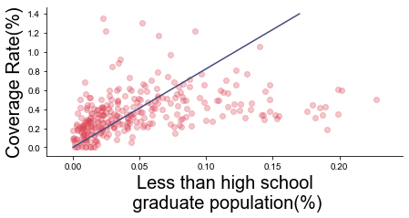
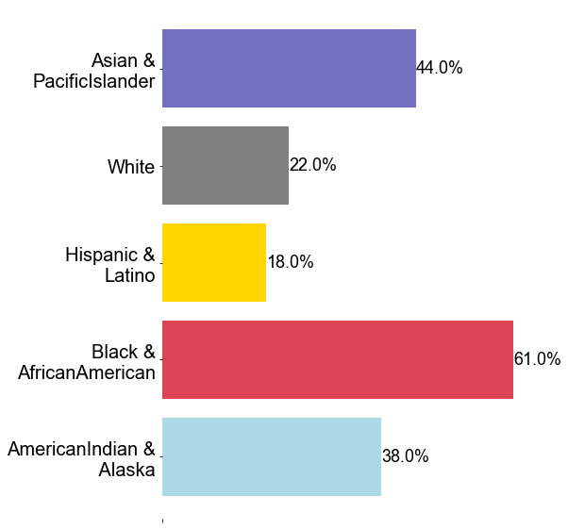
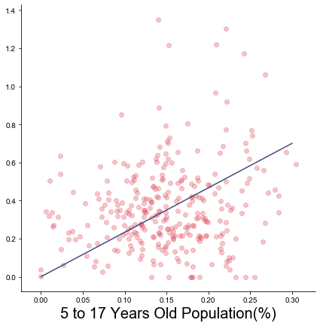
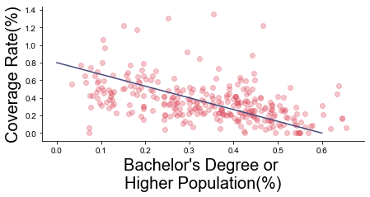
Race, Education, and Age are important features correlated with Coverage Rate
Race & Coverage Rate
Education & Coverage Rate
Age & Coverage Rate
Data source: Taylor & Francis Online article
Notes:
We did a correlation analysis and found that Race, Education and Age are significantly correlated with coverage rate.
Coverage rate in Black and African American is the highest while coverage rate in White, Hispanic and Latino is the much lower.
Education is also what we found highly correlated with the coverage rate. From the chart in the middle, we can see that tracts with lower education levels tend to have higher coverage rates, while tracts with higher education level tend to have lower coverage rate. According to a research in Journal of Hunger and Environmental Nutrition, there is a negative relationship between education and SNAP utilization, which supports our findings. The possible reason might be stigma around participating for SNAP as an educated person. However, to prove whether the education level will affect people’s willingness of reach out for SNAP needs more experiments and tests.
Age are another important feature, tracts with more 5-17 years old population tend to have higher coverage rate. This echoes another finding from the same source mentioned above, that families with children have higher food stamp utilization.

Slide 11
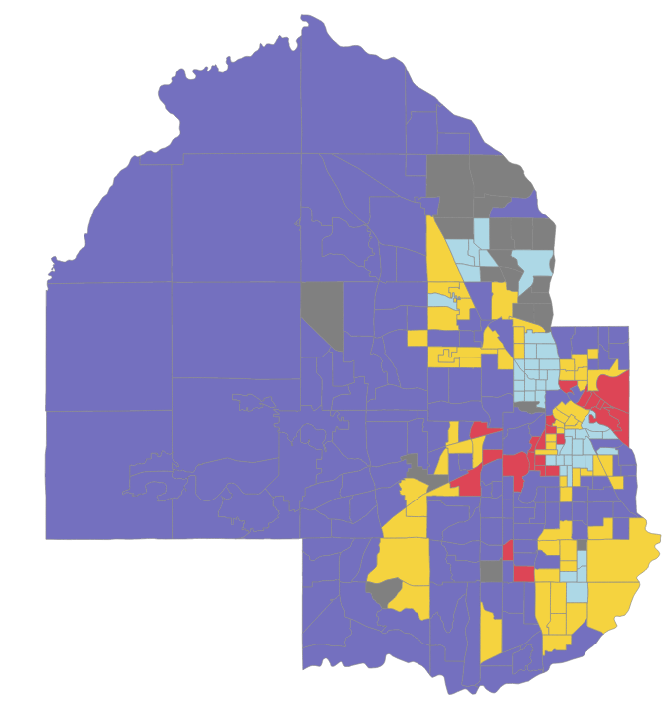
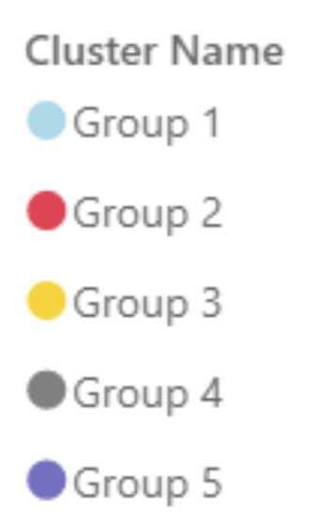
Clustering Modeling: Divide the tracts into 5 Groups According to Their Similarities
Each tract within a group shares similar features
Group1
Group 2
Group 3
More Black
Low Education
More White, Low Education
Low Asian, High Education
Group 4
Group 5
More Asian, High Education
More White, High Education
*Find more information about our model in the Appendix
*Find more information about each group in our power BI dashboard
Notes:
Based on the highly correlated features, we clustered tracts into 5 groups. Each tract within a group shares similar features. For example, tracts in group 1 and 2 have low education level and tracts in group 3,4 and 5 have high education. For detailed group characteristic, please refer to our powerBI dashboard.

Slide 12
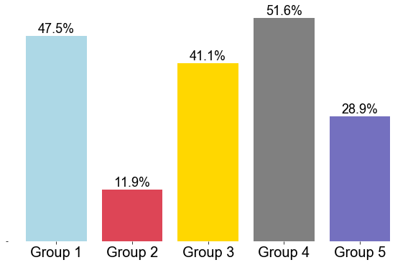

Clustering Modeling: Group 2 and Group 5 Has Below Average Coverage Rate
Coverage Rate For Group 2 and Group 5 are below county average
80% of the low coverage tracts(tract with coverage rate less than 5%) are from Group 5, 10% are from Group 2
Group 2
Average
Coverage Rate is 37.31%
More White, Low Education
Group 5
More White, High Education
*Find more information about our model in the Appendix
Notes:
Next, let’s have a look at the coverage rate for each group. Group 2 and group 5 have a coverage rate below the average line of 37%.
And we found that among all low coverage tracts, 80% are from group5 and 10% are from group2.

Slide 13
Clustering Modeling: Group 2 and Group 5 should be mainly focused
Low Coverage Rate % High
Danger
Good Job!
Demand Gap
62% of the eligible population in Group 2 are White, but only 8.5% of them received SNAP benefit.
66.9% of the eligible population in Group 5 are White but only 20% of them received SNAP benefit
1. More Black
Low Education
2. More White, Low Education
Low Eligible Population % High
3. Low Asian, High Education
Caution
Keep
4. More Asian, High Education
If SNAP can improve the white population coverage rate to the average level, the overall coverage rate in the whole county could improve to 42.1% (13% more than current level)
5. More White, High Education
Notes:
Next we analyzed the coverage rate together with the eligible population to find out the demand and supply in each group, and then we can narrow down our target.
From the graph on the left, Group 1 has high eligible population and high coverage, it seems like SNAP is doing well in group 1.
Group 3,4 lies in keep zoom with relative lower eligible population and higher coverage rate.
However, Group 2 lies in danger zoom with high eligible population but low coverage which indicate a demand gap, the penetration in group 2 need to be improved.
And group 5 lies in caution zoom with low eligible population and low coverage rate.
We recommend mainly target at group 2 and group 5 to improve the coverage rate.
Now we have our target groups, we want further find out which race group contribute to their low coverage.
We found that most of the eligible people are white in group 2 and group 5, but the coverage rate is both low.
If the coverage rate in the white population of the two groups are improved to the average level, the overall coverage rate in the whole county will improved to 42%, which is 13% higher than current level.
Next, we will summarize our overall recommendation.

Slide 14
Overall recommendations for better targeting based on analysis
Low Coverage Rate % High
Danger
Good Job!
Groups 1, 3, 4:
Keep the good performance
Find out why we’re doing well in these tracts
1. More Black
Low Education
2. More White, Low Education
Low Eligible Population % High
Groups 2, 5:
Increase reachout personnel for population in Group 2 (high priority) and Group 5 (lower priority)
Find out possible reasons causing the discrepancy in coverage rate
Work on possibly reducing stigma and negative perceptions in Group 5
3. Low Asian, High Education
Caution
Keep
4. More Asian, High Education
5. More White, High Education
Notes:
Based on our analyses, here are some overall strategies to improve Hennepin county’s SNAP coverage rate and maximize assistance provided to individuals that qualify.
First, tracts like Group 1,3,4 have above average SNAP coverage rates. It would be worthwhile for these tract groups to act as reference of good performance and learn from them. What are agents or organizations doing here that is different and maybe contributing to better coverage? Or do these tracts share more SNAP redeeming spots? Related features may be better identified with more surveys.
For groups 2 and 5 that have lower coverage rates, we advise to send more reachout personnel and reduce the disparity. Group 2 has a higher priority due to its lower coverage rate. A possible reason for the low coverage rate in Group 5 that we infer from our data is stigma around the idea of reaching out for SNAP aid as an educated person. Perhaps reachout teams can start with this target group in Group 2
Outreach: people who might not know yet about the program
Grocery stores, food shelves available to use EBT card-> hospitals screen for the SNAP too! Add feature?

Slide 15
Appendix: Assumptions and Methodologies used in data processing
Notes:
Invite questions

Slide 16
Part 1: Assumptions in data processing
Collinearity issue of modeling might impact our explanation
Data cleaning for inconsistencies
Removed racial tract data for unlikely coverage rates, possibly due to large measuring error
Did not do monthly level analysis, subject to too much noise
Some minorities do not have sufficient data for us to conclude reliable results
Used individual level data instead of household, there might be some adjustments based on the household

Slide 17
External Source Links
Page 1 (Hennepin County 18 overall stats)
https://map.feedingamerica.org/county/2018/overall/minnesota/county/hennepin
Page 2 (Eligibility guidelines)
https://www.dhs.state.mn.us/main/idcplg?IdcService=GET_DYNAMIC_CONVERSION&RevisionSelectionMethod=LatestReleased&dDocName=cm_001306#
Page 3 (Poverty by race data source example)
https://www.census.gov/data/tables/time-series/demo/income-poverty/cps-pov/pov-01.2018.html
Page 4 (State-wise SNAP participation numbers)
https://www.kff.org/other/state-indicator/avg-monthly-participation/?activeTab=graph&currentTimeframe=0&startTimeframe=4&selectedRows=%7B%22states%22:%7B%22minnesota%22:%7B%7D%7D%7D&sortModel=%7B%22colId%22:%22Location%22,%22sort%22:%22asc%22%7D
Page 10 (Reference for relationship between education, age & SNAP coverage
https://www.tandfonline.com/doi/full/10.1080/19320248.2016.1146196

Slide 18
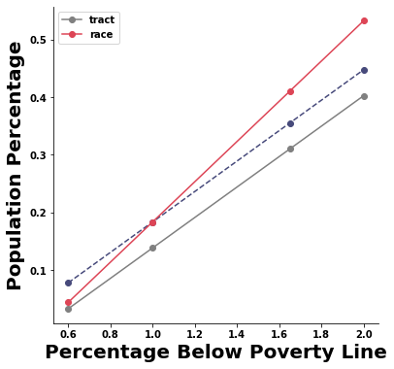
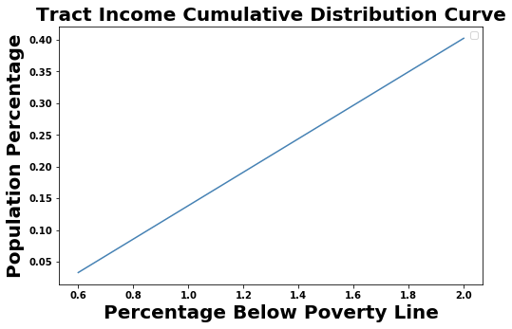
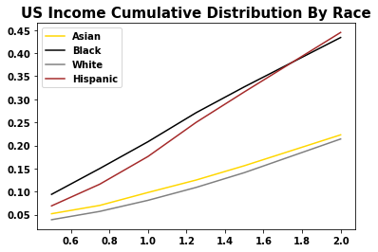
Part 2: Methodology for calculating coverage by race- Adjust distribution curve based on race income data
Income distribution for each tract from ACS data 2018
Below 165% poverty line population percentage of a certain race group in the tract
Below 165% poverty line population percentage of a certain tract
Income distribution for each race from census data 2018

Slide 19
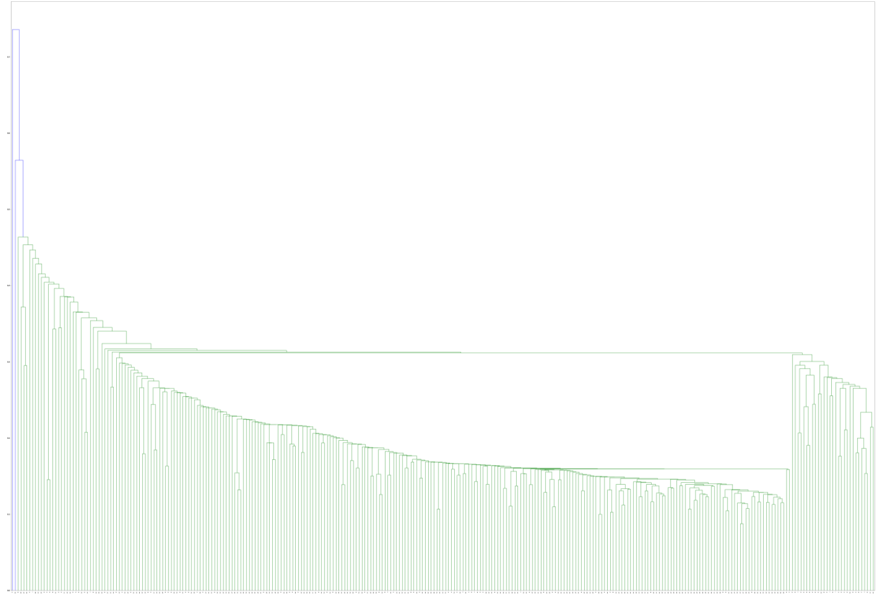
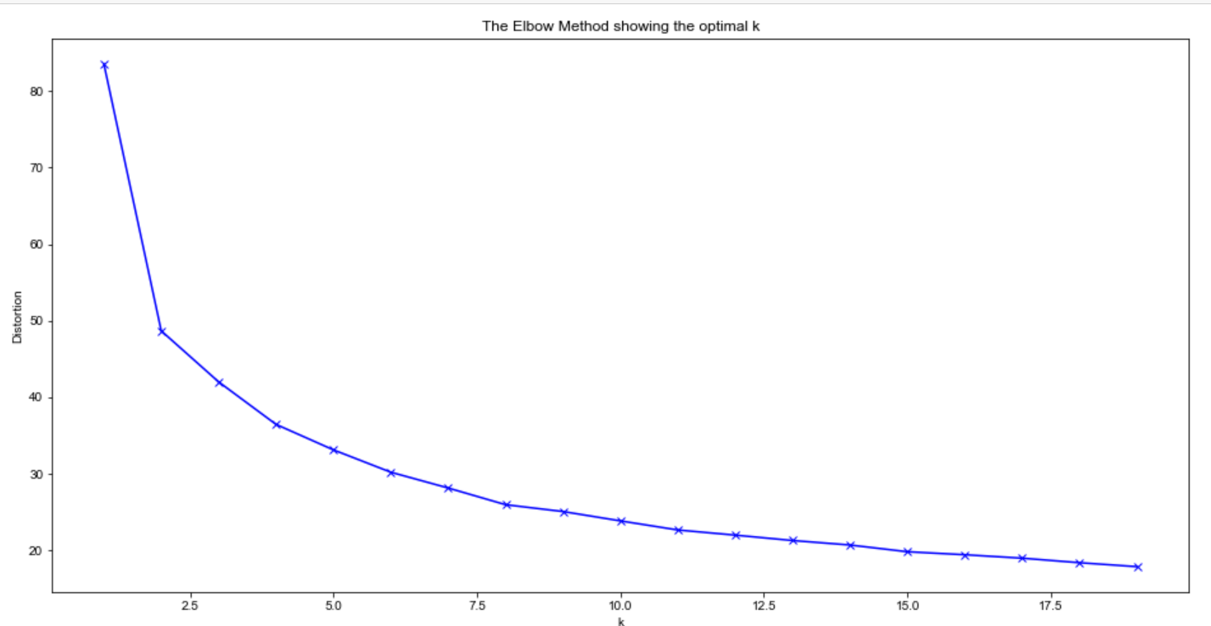
Part 3 (Clustering): Elbow Method used to determine the optimal cluster number
Dendrogram output
Elbow-method output

Slide 20

Part 3 (Clustering): Detailed Group Characteristics
Characteristic of Each Group
Each tract within a group shares similar features*
1.More Black, Low Education
Less White Population
More Black or African American
Lower Education level
Higher poverty level
2.More White, Low Education:
More White Population
Less Black or African American
Higher Unemployment Rate
Less Work Force
More Part-time workers
Lower Education level
Higher poverty level
3.Low Asian, High Education:
Less Asian Population
Higher Education Level
Lower poverty level
4.More Asian, High Education:
More Asian
Higher Education Level
Lower poverty level
5.More White, High Education:
More White Population
Less Black or African American
More work force
Higher Education Level
Lower poverty level
*Find more information about our model in the Appendix
Notes:
Based on the highly correlated features, we clustered tracts into 5 groups. Each tract within a group shares similar features, listed on the right. For detailed group characteristic, please refer to our powerBI.
There are also some shared features within the groups.
For example, Both Group 2 and group 5 have the lowest Black and AfricanAmerican population with highest white population

Slide 21
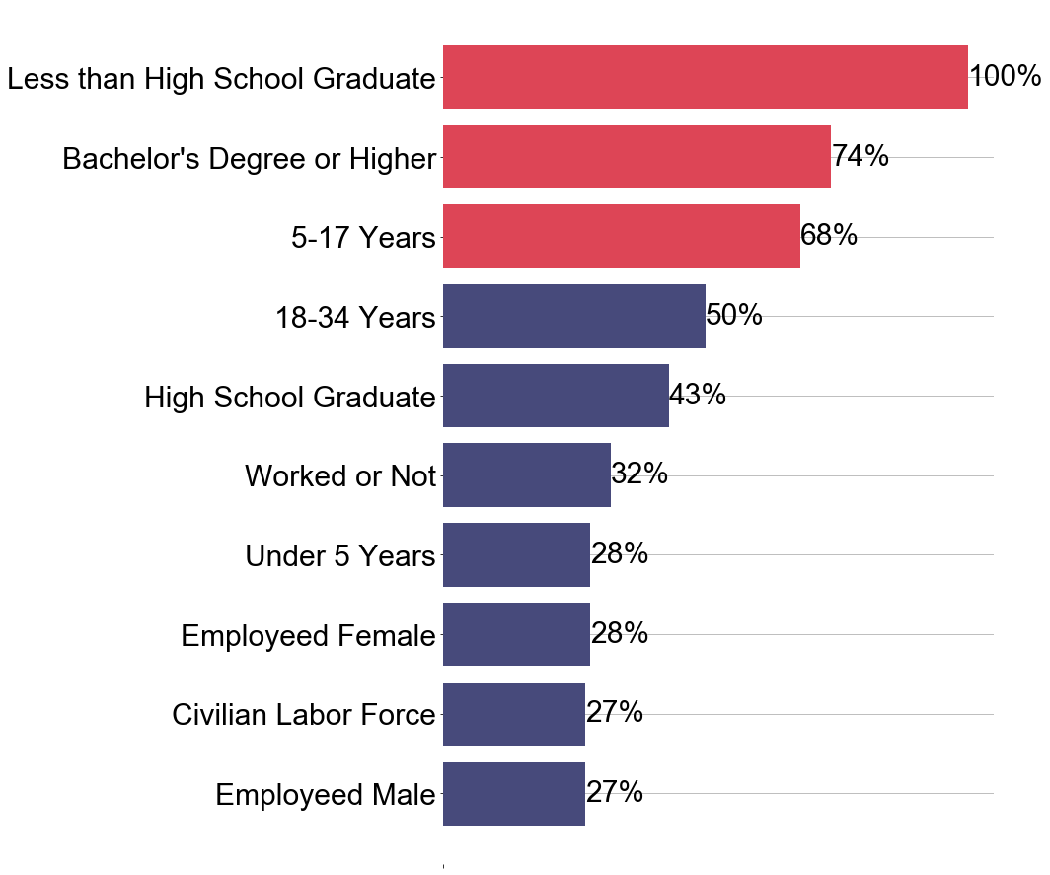
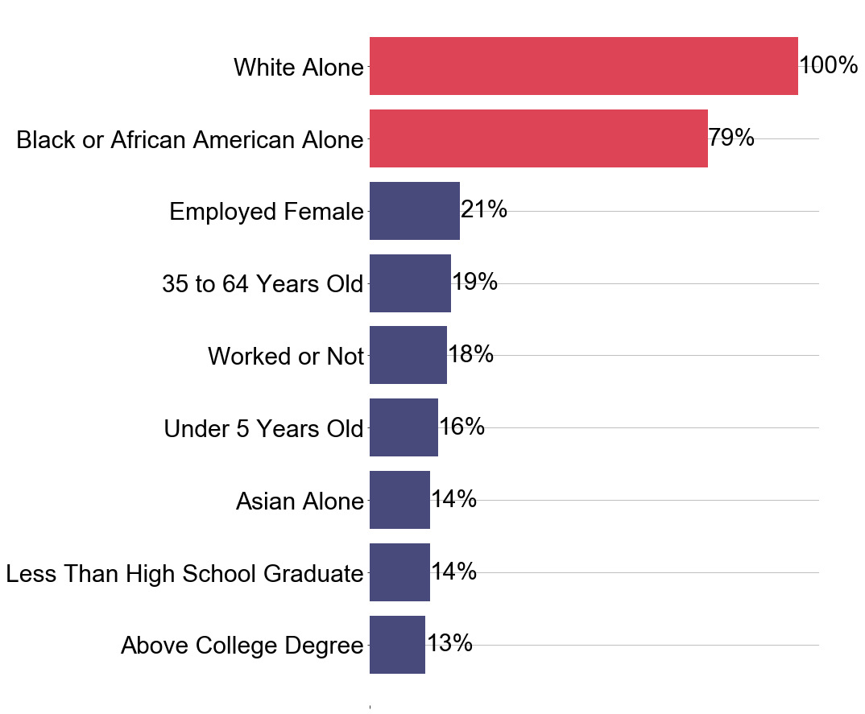
Part 4 (Modeling): Feature Importance
With Race:Ridge Regressor
Exclude Race:Random Forest Regressor

Slide 22
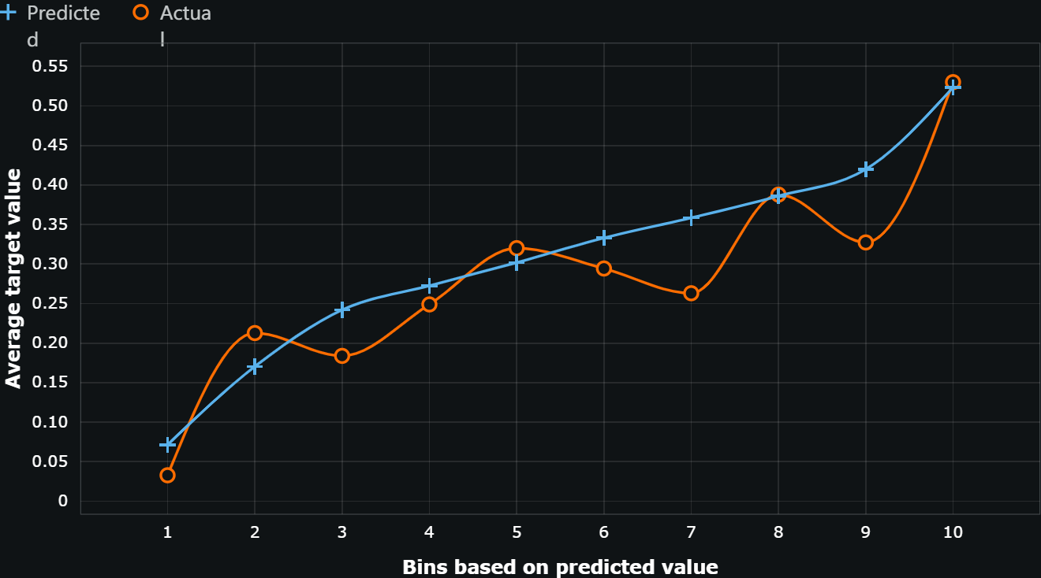
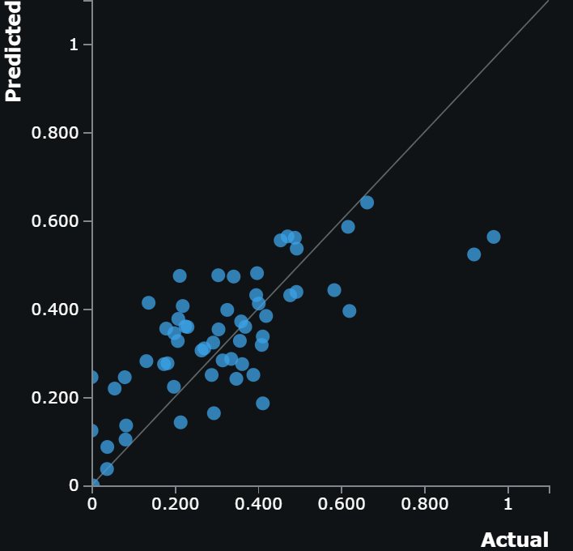
Part 4 (Modeling): Predictive Modeling 1
Model Used:
Ridge Regressor
RMSE in hold out
Validation dataset:
0.1372
Lift Chart of the Model
Residuals:

Slide 23
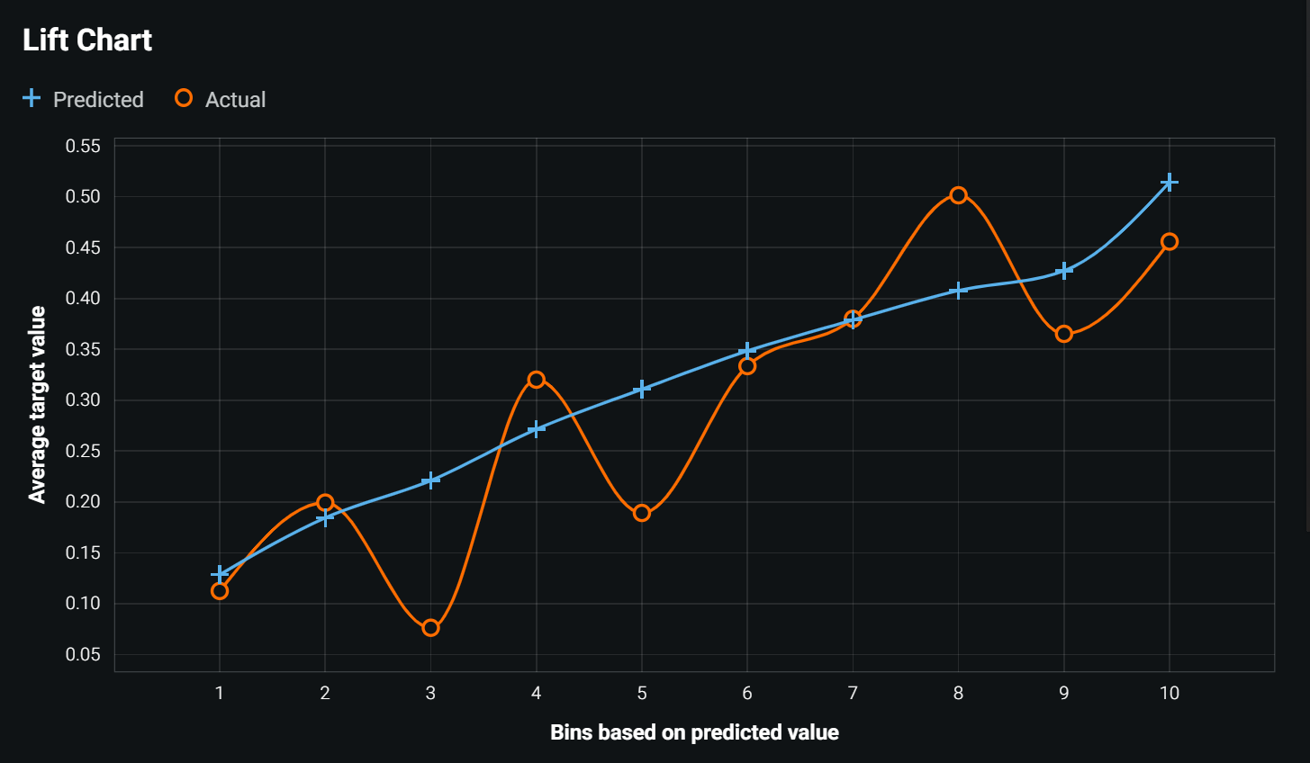
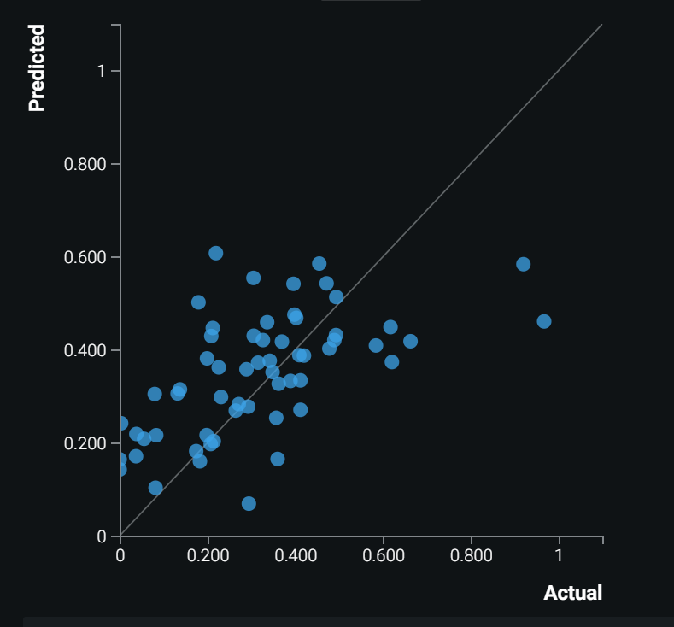
Part 4 (Modeling): Predictive Modeling 2
Model Used:
Random Forest Regressor
RMSE in hold out
Validation dataset:
0.1640
Lift Chart of the Model
Residuals:

